Slide 1
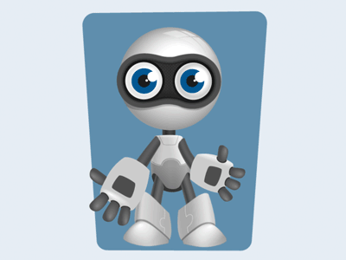
Welcome to Robotics 2021!
Where we build stuff in order to make stuff and learn stuff along the way.

Slide 2

This Photo by Unknown Author is licensed under CC BY-SA-NC

Slide 3

This Photo by Unknown Author is licensed under CC BY

Slide 4
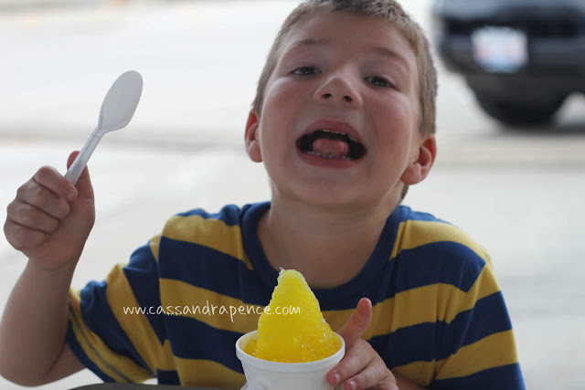
This Photo by Unknown Author is licensed under CC BY-ND

Slide 5
What Are We Building?

Slide 6
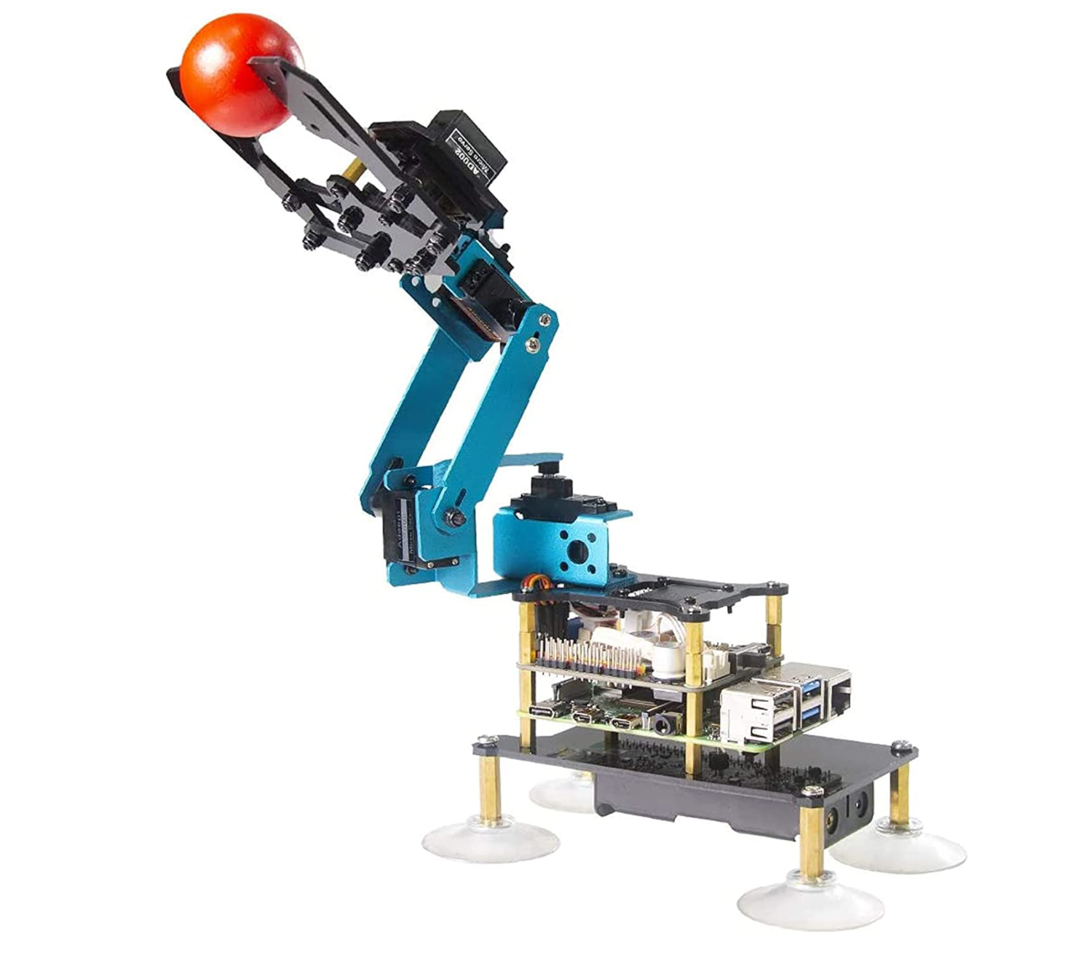
Project #1
Build a robotic arm.
Control it.
Pick up lego bricks.

Slide 7
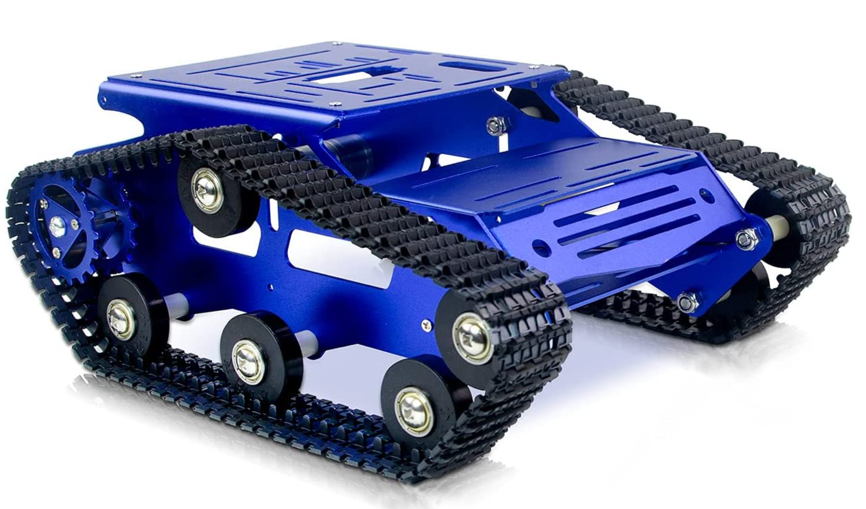
Project #2
Build a tank-steering vehicle.
Learn to drive it.
Learn to follow a line.
Transport lego bricks and dump them.

Slide 8
Six Robotics Teams
6

Slide 9
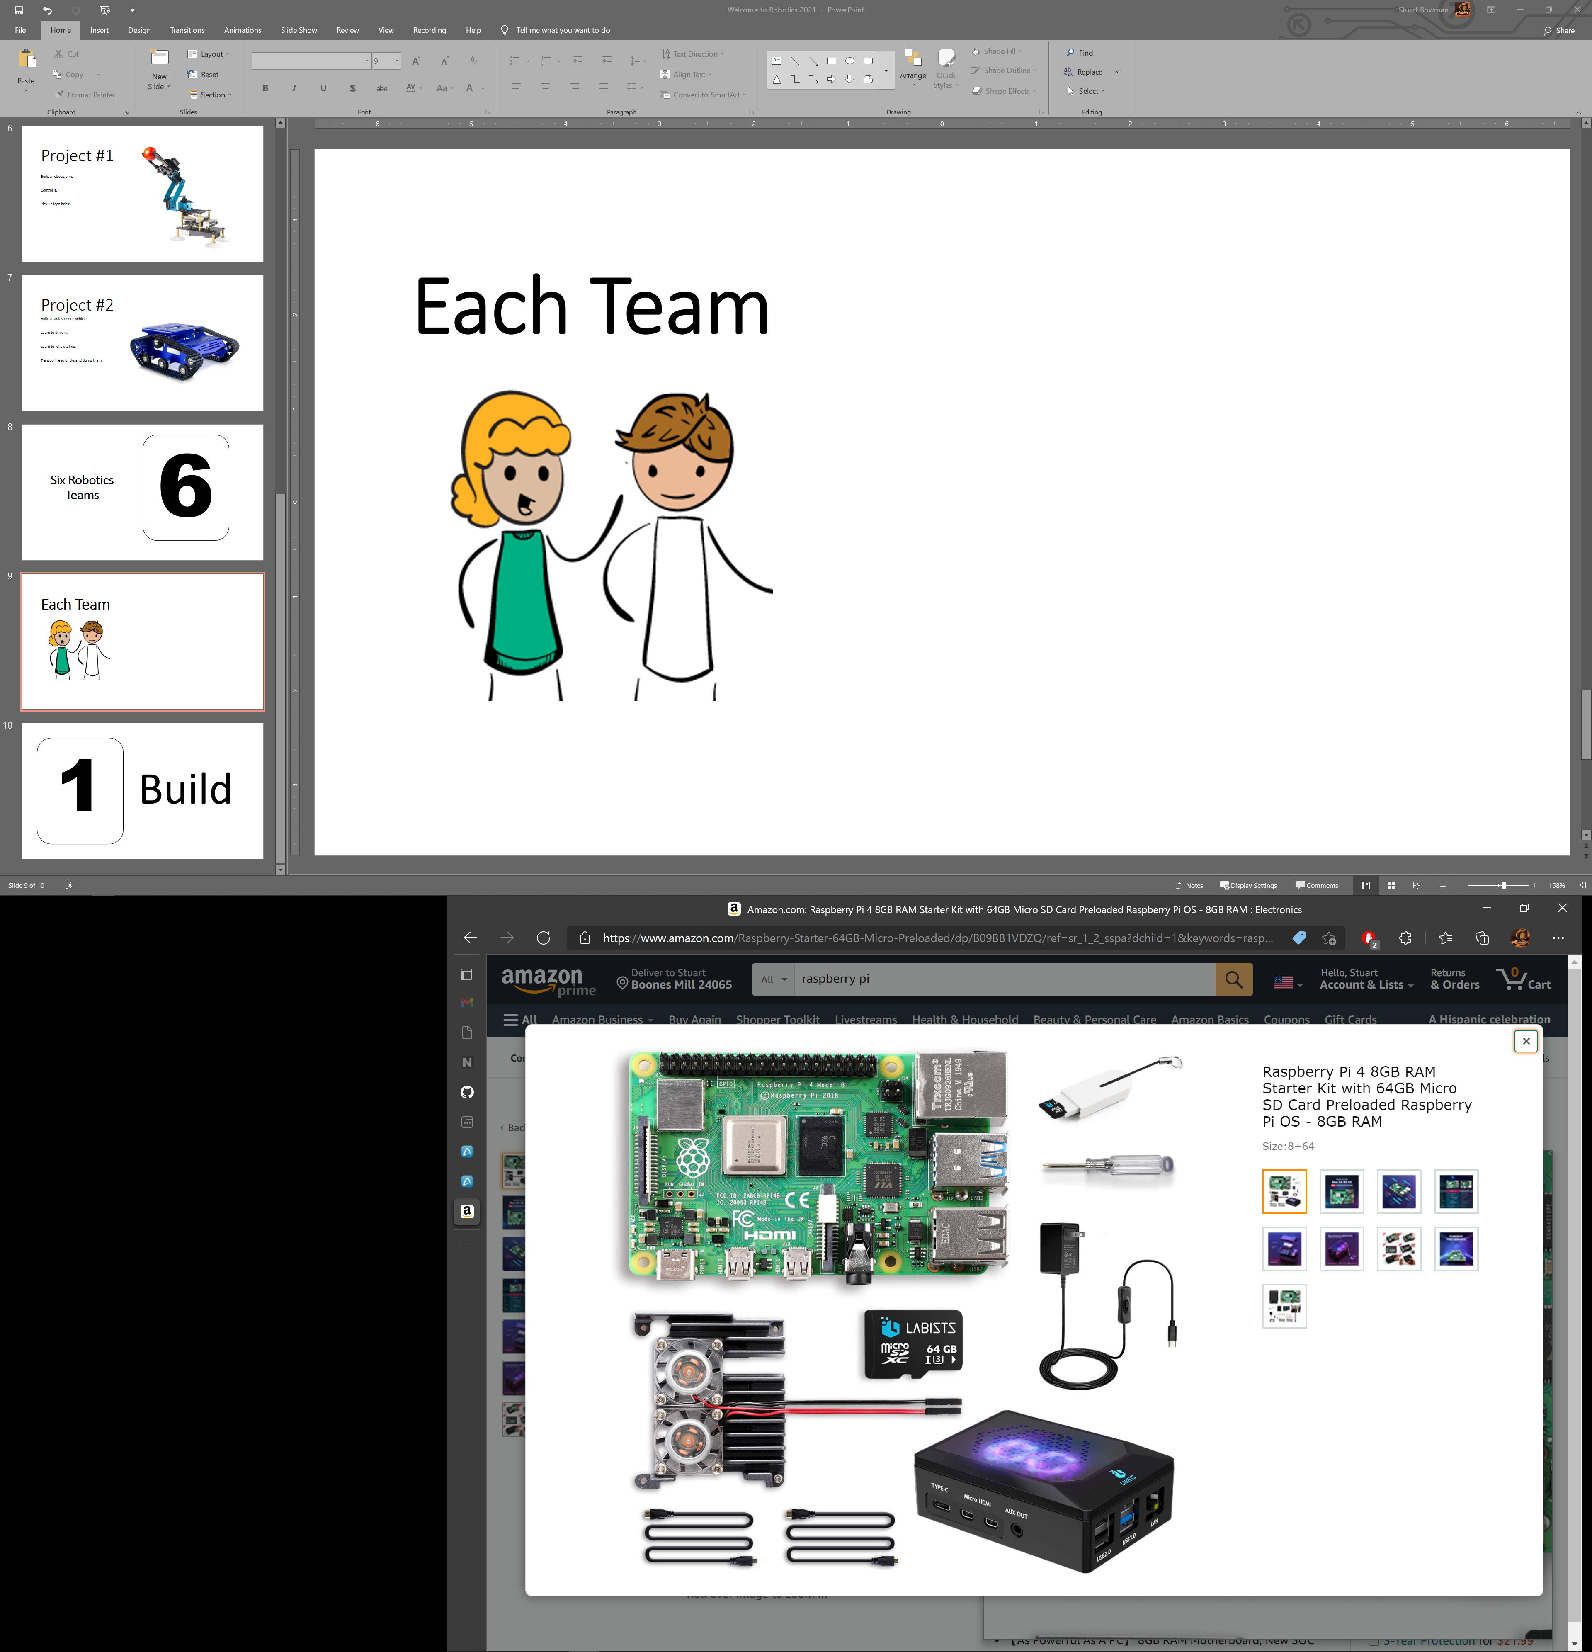

Each Team

Slide 10
1
Build

